Slide 1


ON ROAD VEHICLE BREAKDOWN ASSISTANCE
Presented by:
D V SAI KUMAR-192372321
CSA4306 - INTERNET PROGRAMING FOR APPLICATIONS
Guided By :
Dr . SARAVANAN KUMAR S K
Date:05-05-2025

Slide 2
ABSTRACT
Develop a system to provide timely assistance to vehicles that suffer a breakdown while on the road.
Covers cars, bikes, trucks, and other vehicles. Provides services like towing, fuel delivery, battery jump-start, flat tire change, and mechanic dispatch.
Enables users to request help with GPS location tracking. Helps assistance providers locate the user quickly. Allows mechanics and towing services to accept requests. Keeps users informed with ETA and service updates. In-app payments for service charges. Allows users to rate services for quality assurance.
Android/iOS app or web dashboard. Cloud-based server, REST APIs. GPS integration for accurate location-based services. Database to store user, vehicle, and service provider details.
Reduces waiting time during emergencies. Increases road safety and convenience. Digitizes roadside assistance services. Boosts efficiency and response rate for service providers.
Individual vehicle owners, fleet operators, and roadside assistance companies.

Slide 3
PROBLEM STATEMENT
Vehicle breakdowns on roads cause inconvenience, stress, and safety risks for drivers.
In remote or unfamiliar areas, it is difficult for drivers to locate nearby assistance services
quickly.
The current process of contacting roadside help is mostly manual, time-consuming, and inefficient.
There is a lack of real-time systems that can automatically connect users with nearby service providers.
Delays in getting assistance can lead to traffic congestion, missed appointments, or further damage to the vehicle.

Slide 4
LITERATURE REVIEW
Relied on manual calls to towing services or automobile clubs. Often suffered from delays due to lack of location precision and availability of nearby service providers.
GPS technology has improved location accuracy in modern navigation systems. Studies show GPS integration significantly reduces response time in emergency services.
Apps like Uber for Towing and Car24x7 introduced mobile-based service requests. Literature supports the efficiency of real-time communication between user and service provider.
Cloud systems improve scalability and real-time data sharing. Research highlights their role in enabling fast service allocation and response.
Integration of IoT and OBD-II systems allows real-time vehicle health monitoring. Research papers indicate potential for predictive maintenance and automated fault alerts.

Slide 5
System Design / Architecture
Existing System:
Users can select the type of breakdown service needed (e.g., flat tire, fuel delivery, battery jump-start, towing).
The system automatically detects the user's location using GPS and sends it to the server in real-time.
Nearby verified service providers are located using a geo-matching algorithm and notified of the request.
Service providers can accept or decline requests through their dedicated service provider app.
Once a request is accepted, the provider’s location and estimated time of arrival (ETA) are shown to the user on a live map.
Most existing systems rely on manual methods like calling local mechanics or roadside assistance services.
Services such as AAA (in the US) or some private insurance-based roadside assistance programs operate via helpline numbers and manual dispatch.
Location tracking in existing systems is either non-existent or based on verbal communication, leading to delays in locating the user.
Some modern service providers have basic mobile apps, but many lack real-time tracking and automated service allocation.
:

Slide 6
ALGORITHM IMPLEMENTATION
User Request
User selects service type and GPS fetches current location.
Request (with location and service type) sent to the server.
Nearby service providers are notified based on proximity.
2. Service Provider Matching
Providers ranked by distance, expertise, and availability.
Top-ranked provider receives the request and has a set time to accept.
Upon acceptance, provider’s location and ETA are shared with the user.
3. Real-Time Tracking
GPS tracks user and provider in real-time.
User receives updates (en route, arrived, service complete).

Slide 7
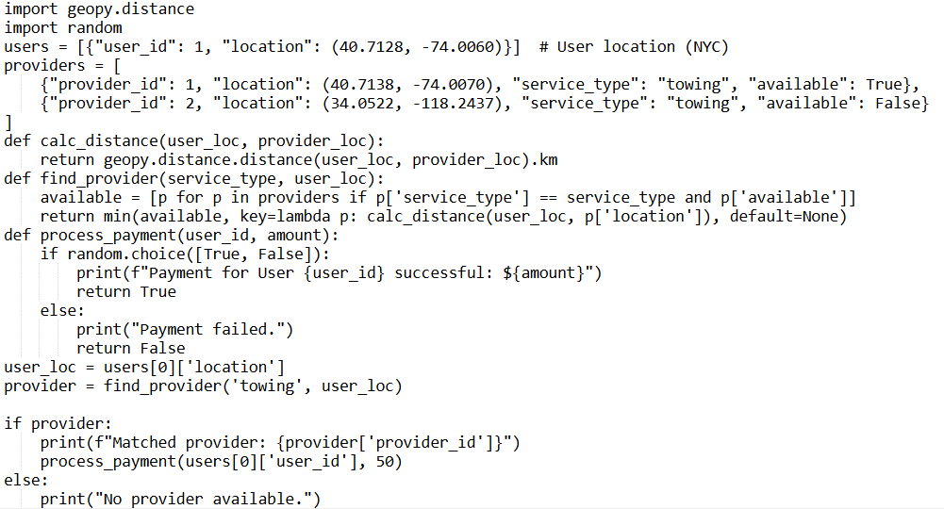
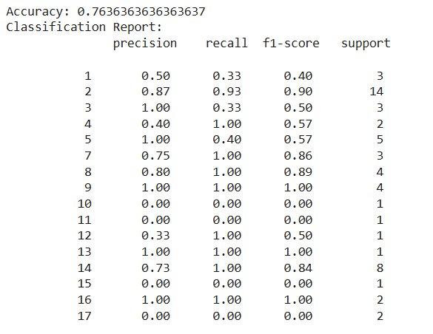
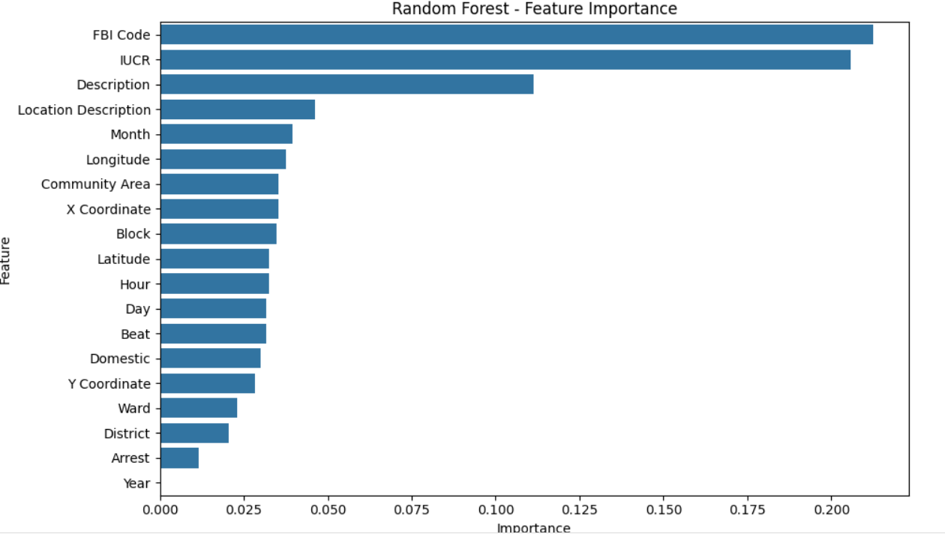
code

